Slide 1
Infrared Sensors
Raymond Dang|N01048235 | CENG 317

Slide 2
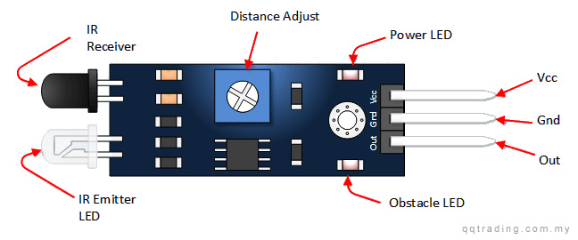
Introduction to Infrared Sensors
Infrared Sensor (IR) incorporated with Ultra-Sonic sensor , motor driver and time-of-flight
Usage of all the sensors into a robotic vacuum
IR sensors can detect motion up to 30cm or objects that pass in front of the sensor
The way it operates is that the emitter will send out a signal and the signal will be detected by the receiver
Specifications for the IR avoidance sensor:
Vcc: 3.3v to 5v
Detection from 2cm-30cm depending on potentiometer

Slide 3
Budget of Project
Items Required | Price ($CAD) | Total | Where to purchase
Raspberry pi 3 starter kit | $99.99 + tax = $112.99 | Amazon.ca
Infrared obstacle sensor(2) | $11.50 + tax = $13.00 | Amazon.ca
Jumper wires (M-F , M-M) | $10.99 + tax = $12.42 | Amazon.ca
IR emitter & receiver (pack of 20) | $9.56 +tax = $10.80 | Amazon.ca
 | Total Cost = $149.21

Slide 4
Project Schedule
Week 1-5
In class quiz (w1)
Selection of project and proposal (w2)
Week 6-10
Week 11-12
Presentation of powerpoint (w11)
Project schedule (w3)
Progress report acquiring all parts (w4)
PCB due with blinking LED and reading sensors (w7)
Obtaining parts towards project (w5)
Solder parts to PCB (w6)
Placard due onto our blog (w8)
Script due on blog and build video for Infrared Sensor (w8)
Build video recorded and uploaded (w9)
Progress report of IR sensor and images uploaded onto blog (w10)
Build instructions due (w12)

Slide 5
Demo Of Project
Test Cases:
Bringing an object in the way of the infrared should make the LED and light on the sensor go ON and output on the terminal will say there is an object in the way
Once object is removed from the way of the IR LED and light should go off in the terminal will output that there is nothing in the way

Slide 6
Course Knowledge Utilized
Knowledge of circuits and interpreting schematics to build circuits
Created a program in python on the raspberry pi to control the IR using the GPIO headers on the pi
Soldering parts onto a PCB
Learned how to use GitHub and keep organized with our project by updating our blogs weekly
Problem solving skills such as fixing errors in code or wiring issues with circuits

Slide 7
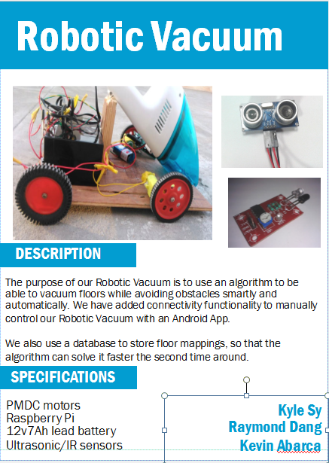

Slide 8
END. Thank you

